Slide 1


KNN Algorithm
Machine Learning

Slide 2


Agenda
Why do you need KNN?
What is KNN?
How do we choose the factor ‘K’?
When do we use KNN?
How does KNN Algorithm work?
Use Case

Slide 3

What is KNN Algorithm?
KNN – K Nearest Neighbors, is one of the simplest Supervised Machine Learning algorithm mostly used for
Classification
It classifies a data point based on how its neighbors are classified

Slide 4
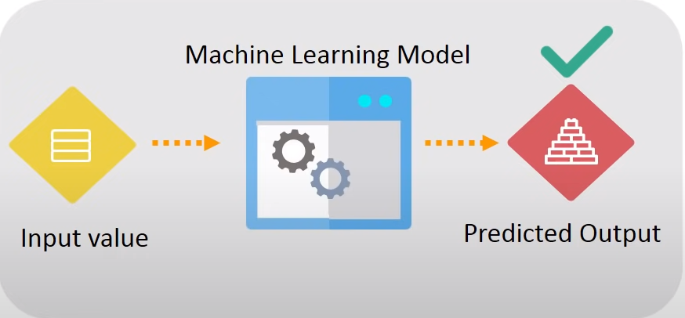
Why KNN?

Slide 5


Slide 6
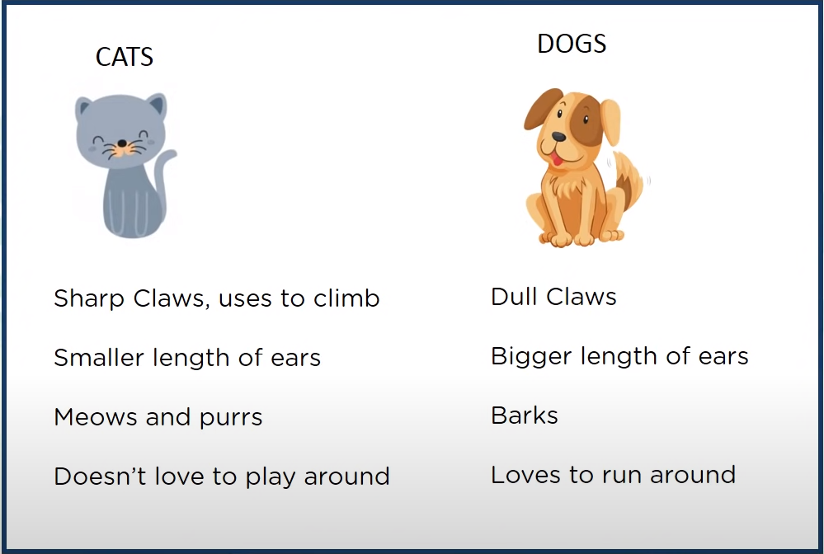

Slide 7


Slide 8
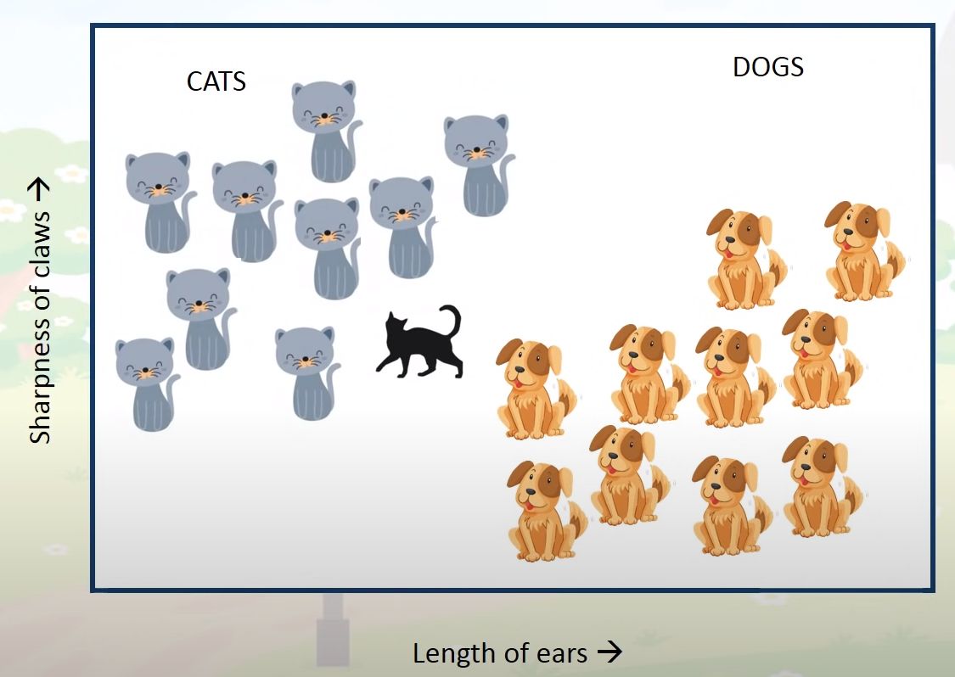

Slide 9
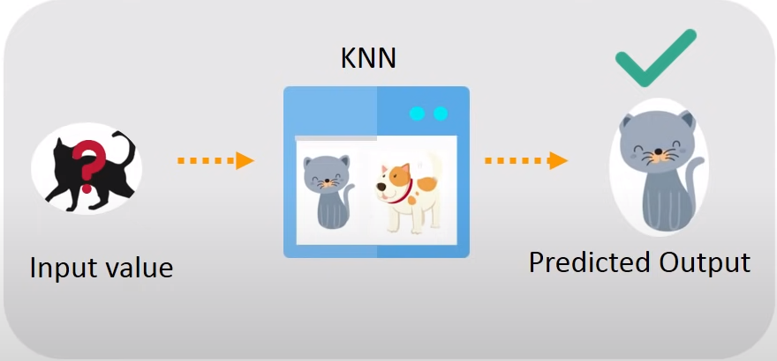

Slide 10
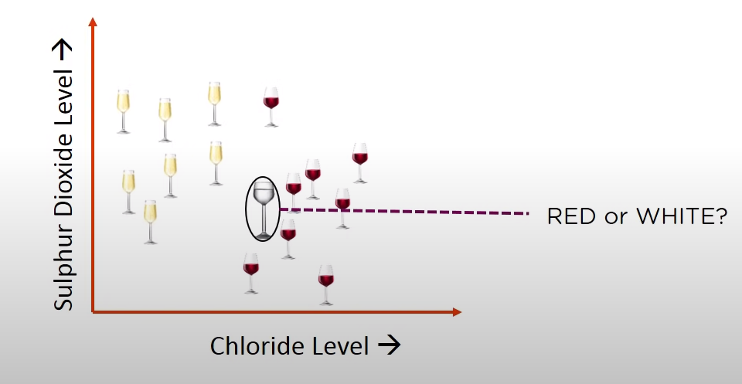
KNN Stores all available cases and classifies new cases based on a similarity measure

Slide 11
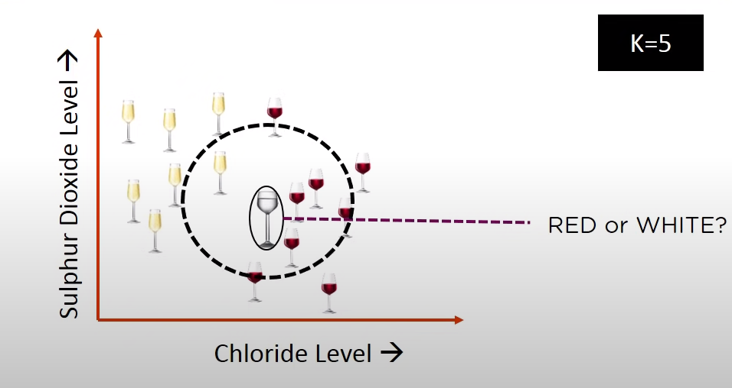
K in KNN is a parameter that refers to the number of nearest neighbors to include in the majority voting process
A data point is classified by majority votes from its 5 nearest neighbors
The unknown point would be classified as RED, since 4 out of 5 neighbors are RED

Slide 12
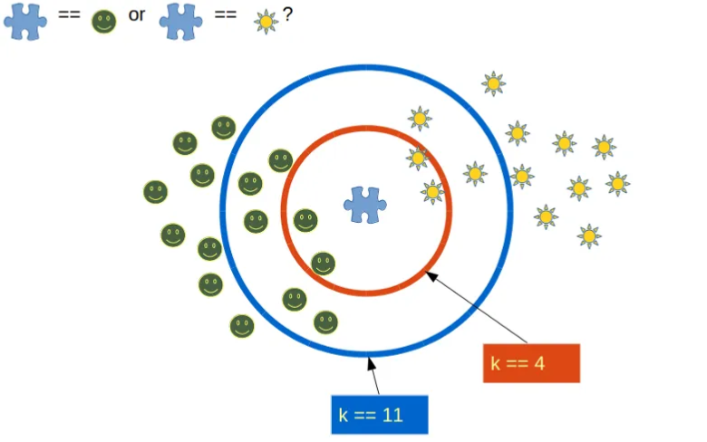
How do we choose the factor ‘K’?

Slide 13
To choose a value of K:
Sqrt(n), where n is the total number of data points
Odd value of K is selected to avoid confusion between two classes of data

Slide 14


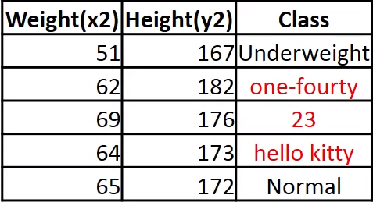
When do we use KNN?
Data is labeled
Data is noise-free
Dataset is small
CAT
Because KNN is a ‘last learner’ i.e. doesn’t learn a discriminative function from the training set

Slide 15
How does KNN Algorithm work?

Slide 16
On the basis of the given data we have to classify the below set as Normal or Underweight using KNN
Weight(x2) | Height(y2) | Class
51 | 167 | Underweight
62 | 182 | Normal
69 | 176 | Normal
64 | 173 | Normal
65 | 172 | Normal
56 | 174 | Underweight
58 | 169 | Normal
57 | 173 | Normal
55 | 170 | Normal
57 | 170 | ?

Slide 17
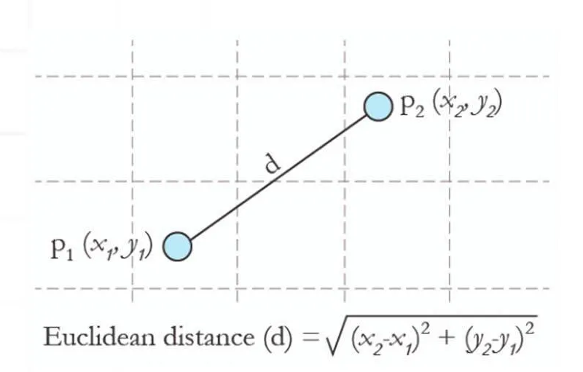
What is Euclidean distance?
4 Types of Distance Metrics in Machine Learning
Euclidean Distance (欧几里得距离)
Manhattan Distance (曼哈顿距离)
Minkowski Distance (闵可夫斯基距离)
Hamming Distance (漢明距離)
https://www.analyticsvidhya.com/blog/2020/02/4-types-of-distance-metrics-in-machine-learning/

Slide 18
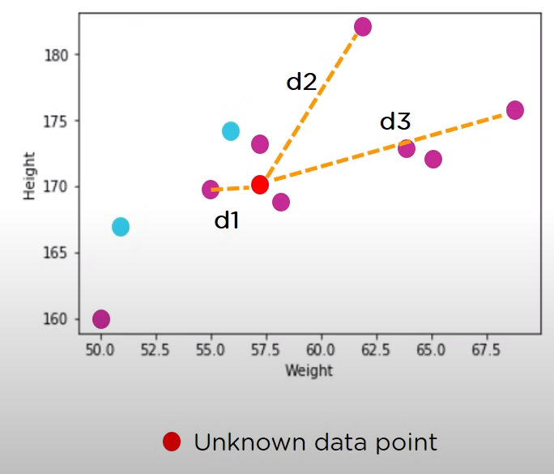

dist(d1) = √(170-167)^2 + (57-51)^2 =6.7
dist(d2) = √(170-182)^2 + (57-62)^2 =13
dist(d3) = √(170-176)^2 + (57-69)^2 =13.4
…
Similarly, we will calculate Euclidean distance of unknown data point from all the points in the dataset

Slide 19
Hence, we have calculated the Euclidean distance of unknown data point from all the points as shown:
Weight(x2) | Height(y2) | Class | Euclidean Distance
51 | 167 | Underweight | 6.7
62 | 182 | Normal | 13
69 | 176 | Normal | 13.4
64 | 173 | Normal | 7.6
65 | 172 | Normal | 8.2
56 | 174 | Underweight | 4.1
58 | 169 | Normal | 1.4
57 | 173 | Normal | 3
55 | 170 | Normal | 2
57 | 170 | ?

Slide 20
Weight(x2) | Height(y2) | Class | Euclidean Distance
69 | 176 | Normal | 13.4
62 | 182 | Normal | 13
65 | 172 | Normal | 8.2
64 | 173 | Normal | 7.6
51 | 167 | Underweight | 6.7
56 | 174 | Underweight | 4.1
57 | 173 | Normal | 3
55 | 170 | Normal | 2
58 | 169 | Normal | 1.4
57 | 170 | Normal
K = 3
So, majority neighbors are pointing towards ‘Normal’
Hence, as per KNN algorithm the class of (57,170) should be ‘Normal’

Slide 21
Use Case

